Slide 1

Visvesvaraya Technological University Belagavi
Project Seminar on
“SMART GLASSES FOR BLIND”
by
Under the guidance of
ROOPA BS
Assistant Professor
Department of Electronics and Communication Engineering
JNN College of Engineering, Shimoga- 577204
2020-2021
RAMAMANOJ Y S: 4JN17EC069
SALEEMULLA K G : 4JN17EC080
SUBHASH M B : 4JN17EC099
RATHAN KUMAR H R : 4JN18EC417
Batch 26

Slide 2
Presentation Flow
Introduction
Literature survey
Aim of the Project
Objectives
Methodology
Results and Discussion
Conclusion
Action Plan
References

Slide 3
Introduction
According to the World Health Organization, there are nearly 285 million people with some form of visual impairment out of which 86% people have low vision and 14% people are blind.
Blindness means complete or partial loss of vision.
There are many types of blindness like, legally blind, total blindness and congenital blindness.
Legal blindness can be cured by powered glasses, while the total blindness and congenital blindness cannot be cured by eye ball transplant or by any other methods.

Slide 4
Introduction
So they came across many problems like finding the objects in their surroundings, to avoid obstacles in their path and depending on others for their daily routine.
To overcome all these problems we design smart glasses using machine learning and deep learning algorithms.
Deep learning is an artificial intelligence function that imitates the working of the human brain in processing data and creating patterns for use in decision making.
You only look once, or YOLO, is one of the faster object detection algorithms in the present use, it is often used when a real−time detection is needed and without loss of too much accuracy.

Slide 5
Introduction
With YOLO, it is possible to predict bounding boxes and class probabilities in a single go from full images. As the entire detection work flow is a single network, it can be optimized end−to−end directly.
YOLO algorithm is a very fast technique, it looks at the image as a one whole image while making predictions, unlike sliding window and region proposal-based techniques, It just looks at the entire image during test time and runs it through the neural network to detect predictions at once.
YOLO represents the objects in a genralised fashion. YOLO which when trained on natural images and tested on artwork, gives better results than most of the other algorithms which are more accurate and top detection algorithms such as Deformable Part Models and Region Based Convolutional Neural Network by a large margin.

Slide 6
Literature Survey
1. Jung-Hwna Kim, Sun-Kyu Kim, Tea-Min Lee, Yong-Jin Lim and Joonhong Lim, ”Smart Glasses using Deep Learning and Stereo Camera” 8th Global Conference on Consumer Electronics (GCCE) IEEE 2019.
In this paper we came across The smart glasses using Deep learning and Web camera.
The object detection and recognition done through YOLOv3 algorithm.
Obstacle recognition can also done through YOLOv3 Deep learning algorithm.
YOLOv3 performs multilabel classification for objects detected in images to alert the user.

Slide 7
Literature Survey
2.Feng Lan, Guangtao Zhai and Wei Lin, “Lightweight Smart Glass System with Audio Aid for Visually Impaired People”, Institute of Image Communication and Information Processing, Shanghai Jiao Tong University, Shanghai, China.
In this we came across the image processing libraries of Open-CV.
Open-CV is an open source library containing 500 optimized algorithms for image and video analysis
Noise removal using image processing algorithms in Open-CV.

Slide 8
Literature Survey
3.Hawra AlSaid, Lina AlKhatib, Aqeela AlOraidh, Shoaa AlHaidar, Abul Bashar, “Deep Learning Assisted Smart Glasses as Educational Aid for Visually Challenged Students” College of Computer Engineering and Sciences Prince Mohammad Bin Fahd University.
In this paper the processed object converted to text and GTTS is used to convert the text to speech for audio aid for the user.
Raspberry pi 3b b+ module came with audio jack so it assists the use of headphones without USB ports for audio assistance.

Slide 9
Literature Survey
4.Josh Jia-Ching Ying, Chen-Yu Li, Guan-Wei Wu, Jian-Xing Li, Wei-Jheng Chen, and Don-Lin Yang, “A Deep Learning Approach to Sensory Navigation Device for Blind Guidance”, 2018 IEEE 20th International Conference on High Performance Computing and Communications; IEEE 16th International Conference on Smart City; IEEE 4th Intl. Conference on Data Science and Systems.
This paper came across the object detection and recognition done through YOLOv3 algorithm.
The Open-CV libraries for video analysis.
Audio output through the speakers.

Slide 10
Aim of the Project
To Study, design and implementation of Smart Glasses using Deep learning.

Slide 11
Objectives
To design and test the algorithm to detect outdoor and indoor obstacles.
To find the distance from the obstacle using ultrasonic sensors.
To design and test the algorithm to find out the requirements of the user, like objects, doors, chairs etc to avoid dependency in their daily routine.
To assist the user with audio regarding obstacles.

Slide 12
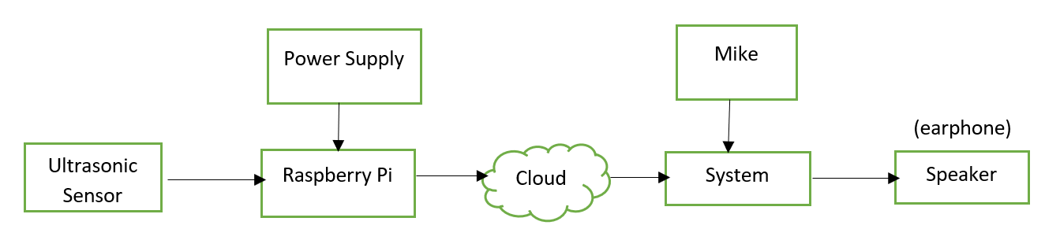
Block Diagram

Slide 13
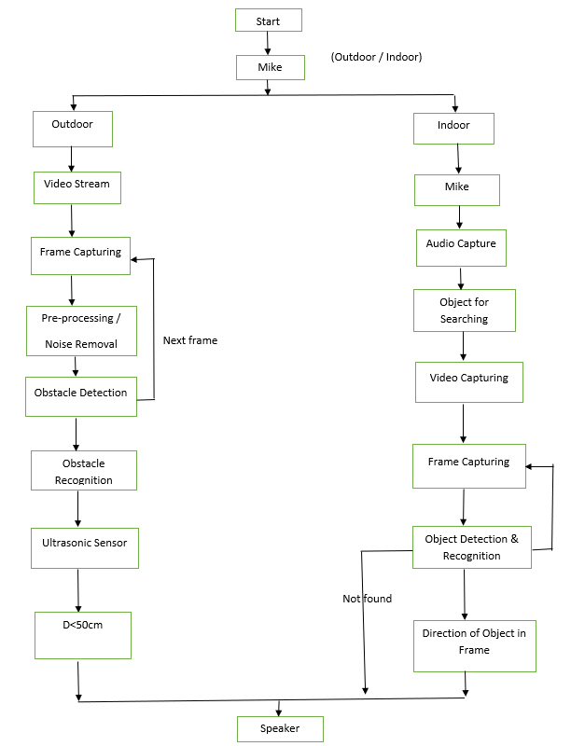
Flow chart
Next frame

Slide 14
Methodology
1.To detect the type of obstacle in outdoor and distance from the obstacle for blind assistance.
By switching to an outdoor mode by voice command.
Camera will switch on and captures the video.
Frame capturing is done at regular intervals of time.
Captured frames are preprocessed and fed to YOLOv3 algorithm one by one to detect and recognize if any obstacle.
If the obstacle found, the ultrasonic sensor will switch on and records the distance of the obstacle.
If distance < 50cm it alerts the user though the speakers using GTTS.

Slide 15
Methodology
2.To find some objects like books, chairs and doors etc in the surrounding environment in indoor mode to assist the user with audio.
By switching to an indoor mode by voice command.
The mike will be on and take audio input from the user and convert it into text using google speech to text.
By selecting the appropriate word, the camera will switch on and starts capturing.
From the video the frame capturing is done at regular intervals of time.
Frames are preprocessed, objects are detected and recognized through YOLOv3 algorithm.
By using video coordinates the user is assisted with audio using google text to speech method.

Slide 16
Methodology
3.YOLOv3 (You Look Only Once version3):
YOLO is shortened form of you look only once and it uses convolutional neural network for object detection.
YOLO can detect multiple object on a single image.
It also detects the location of the objects on the image.
Computationally very fast, can be used an real time environment, maintain high accuracy range.
YOLO apply single neural network to the whole image.
It predicts number of bounding boxes that covers some region on image and chooses the best one according to the probabilities.

Slide 17
Methodology
How does the YOLO Framework Function?
Now that we have grasp on why YOLO is such a useful framework, let’s jump into how it actually works. In this section, I have mentioned the steps followed by YOLO for detecting objects in a given image.
YOLO first takes an input image.
The framework then divides the input image into (S * S) grids.
Grid cells are responsible for detecting the objects from the image.
If the center or midpoint of an object falls into a grid cell, that cell is responsible for detecting the object.
Each cell predicts B number of bounding boxes, with a confidence score for each of the boxes.

Slide 18
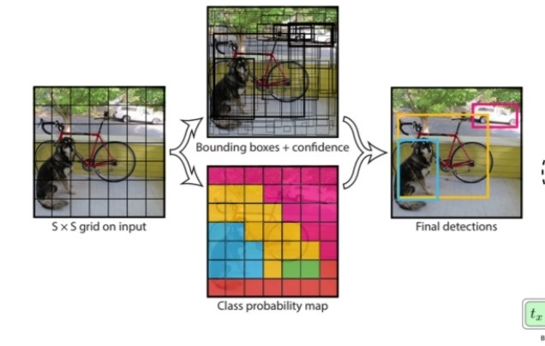
Methodology
Confidence score means how confident the model is that,
1.The box contain an object.
2.How accurately the box has predicted the object boundaries.
Each bounding box consists of predictions x, y, w, h, and the fifth is the confidence score of the grid cell containing an object center.
x, y are the coordinates which represent the center of the box relative to the bounds of the grid cell.
The width(w) and height(h) are predicted relative to the whole image.

Slide 19
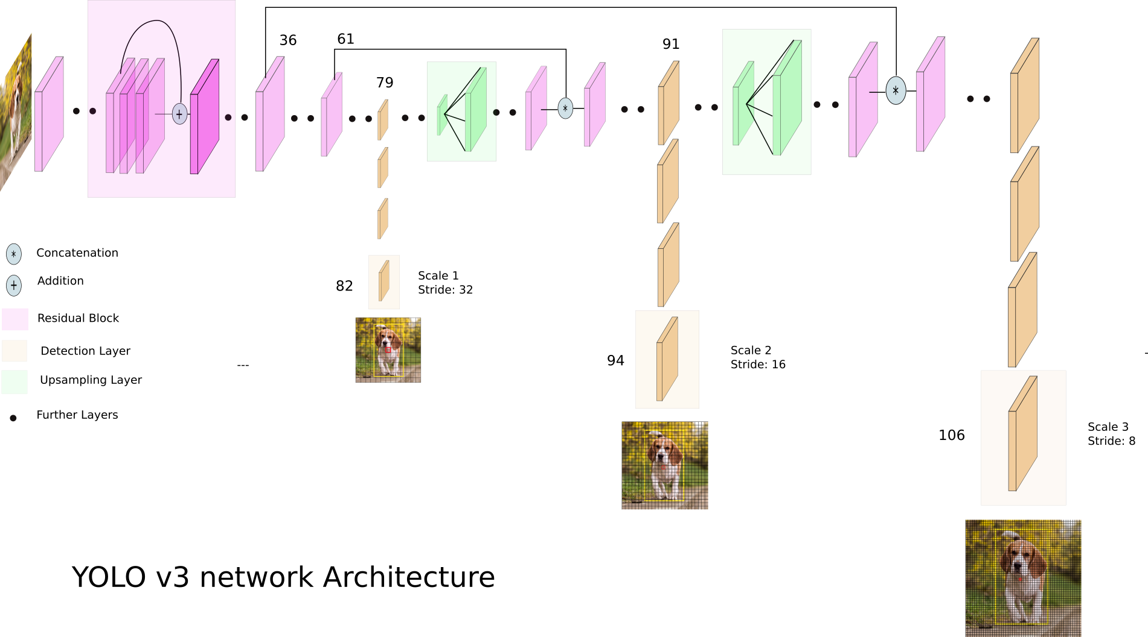
Methodology

Slide 20
Methodology
YOLOv3 uses a variant of Darknet, a framework to train neural networks, which originally has 53 layers.
For the detection task another 53 layers are stacked onto it, accumulating to a total of a 106-layer fully convolutional architecture.
In the convolutional layers, kernels of shape 1x1 are applied on feature maps of three different sizes at three different places in the network.
YOLOv3 has 3 output layers (82, 94 and 106) as shown in fig makes predictions at three scales, given by downsampling the dimensions of the image by a stride of 32, 16, 8 respectively.
Every scale uses three anchor bounding boxes per layer. The three largest boxes for the first scale, three medium ones for the second scale and the three smallest for the last scale. This way each layer excels in detecting large, medium or small objects.

Slide 21
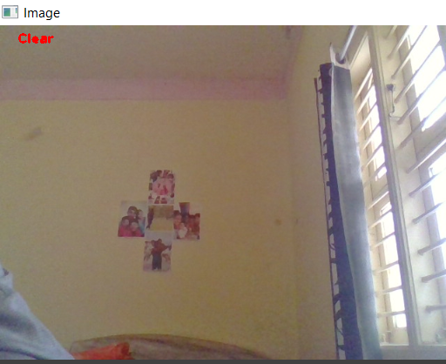
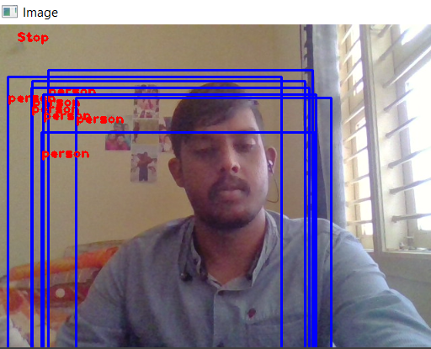

Results obtained and analysis
1.Outdoor_mode.
Path is clear( when no obstacle)
Stop (when obstacle covering max frame)

Slide 22
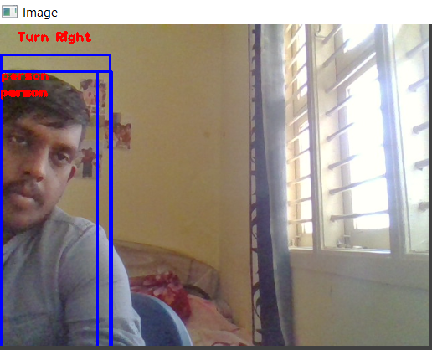
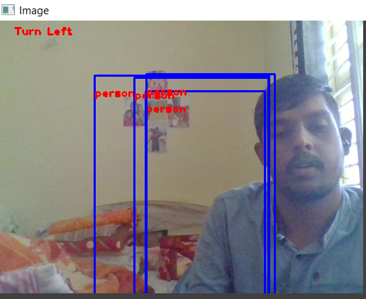
Results obtained and analysis
Turn Right ( if obstacle is in left of the frame)
Turn Left ( if obstacle is in right of frame)

Slide 23
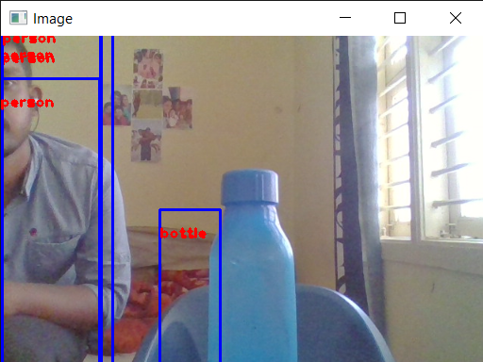
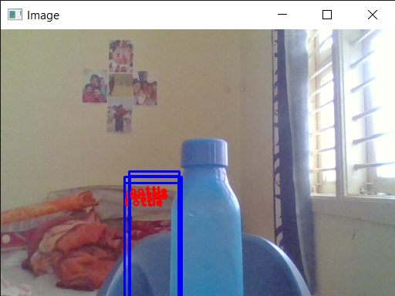
Results obtained and analysis
2.Indoor_mode.
Detecting object in left
Detecting object under the camera

Slide 24
Conclusion
Use of smart glass reduces the dependency of blind persons on others in routine activities.
Yolov3 applies single neural network and it is fastest compared to other object detection algorithms.

Slide 25
Action Plan:
Sl no. | Tasks performed | started | completed | status
1 | Literature Survey | 20/12/2020 | 30/12/2020 | Completed
2 | Synopsis Submission | 31/12/2020 | 02/01/2021 | Completed
3 | Submission for First phase report | 03/01/2021 | 16/01/2021 | Completed
4 | Objective 1 | 01/03/2021 | 01/04/2021 | Completed
5 | Objective 2 | 02/04/2021 | 01/05/2021 | Completed
6 | Objective 3 | 02/05/2021 | 01/06/2021 | Completed
7 | Objective 4 | 02/05/2021 | 01/07/2021 | Completed
8 | Testing & Result Analysis | 02/07/2021 | 10/07/2021 | Completed
9 | Documentation of Project | 11/07/2021 | 15/07/2021 | Completed

Slide 26
References
Jung-Hwna Kim, Sun-Kyu Kim, Tea-Min Lee, Yong-Jin Lim and Joonhong Lim, ”Smart Glasses using Deep Learning and Stereo Camera” 8th Global Conference on Consumer Electronics (GCCE) IEEE 2019.
Feng Lan, Guangtao Zhai and Wei Lin, “Lightweight Smart Glass System with Audio Aid for Visually Impaired People”, Institute of Image Communication and Information Processing, Shanghai Jiao Tong University, Shanghai, China.
Hawra AlSaid, Lina AlKhatib, Aqeela AlOraidh, Shoaa AlHaidar, Abul Bashar, “Deep Learning Assisted Smart Glasses as Educational Aid for Visually Challenged Students” College of Computer Engineering and Sciences Prince Mohammad Bin Fahd University.

Slide 27
References
4. Josh Jia-Ching Ying, Chen-Yu Li, Guan-Wei Wu, Jian-Xing Li, Wei-Jheng Chen, and Don-Lin Yang, “A Deep Learning Approach to Sensory Navigation Device for Blind Guidance”, 2018 IEEE 20th International Conference on High Performance Computing and Communications; IEEE 16th International Conference on Smart City; IEEE 4th Intl. Conference on Data Science and Systems

Slide 28
Questions?

